Slide 1
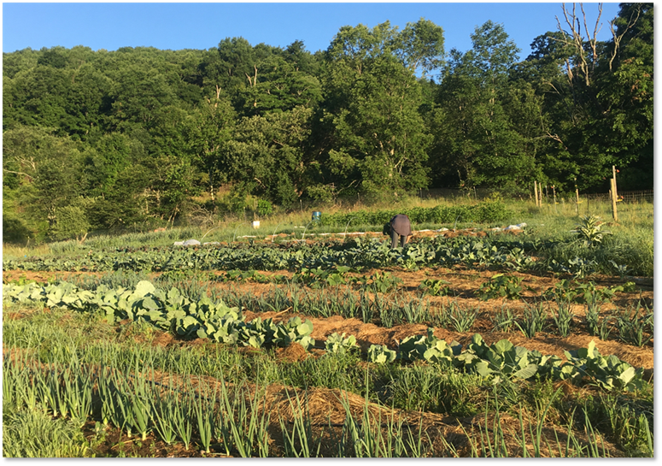
MODULE 5:
Minimize Disturbance
Notes:
This module will focus on ways to improve soil health by reducing disturbance on small-scale and urban farms.
Photo: Elizabeth Marks, USDA NRCS. A small-scale vegetable farm in New York that focuses their soil management on minimizing disturbance.

Slide 2
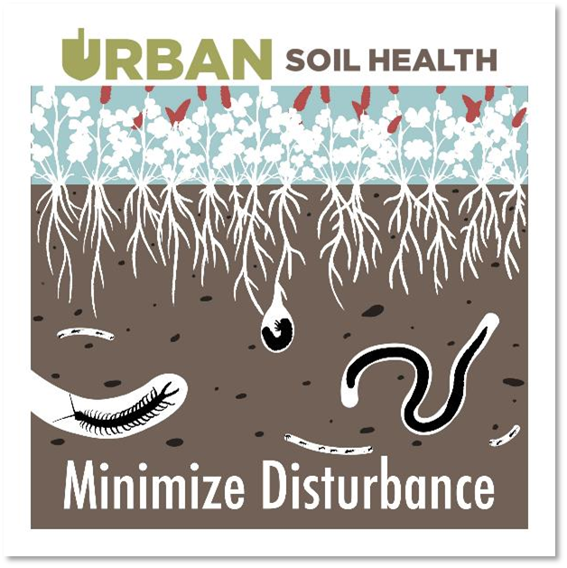
Objectives
Describe methods and approaches to reduce or eliminate tillage in small-scale agriculture systems
Compare CPS 345 Reduced Till and CPS 329 NoTill and their application to small-scale systems.
Discuss the use of NRCS Interim CPS 812 Raised Beds
Notes:
Read through objectives.
Most of this presentation is focused on the first objective, which is to understand the approaches that producers are taking to minimize disturbance on small-scale farms. Reducing tillage has been a topic of tremendous experimentation and discussion within the space of small-scale vegetable production for the past several years. A number of tools and techniques have found widespread adoption through these small-scale grower networks. Many of these tools and techniques are different from those used to reduce tillage on larger farms, but the guiding principle and the resulting improvements to soil health are similar. We will talk through some of these innovations to improve our understanding of how they are being used.
We will also discuss the reasons that producers use tillage on small-scale farm, and look at a conceptual framework for conversations on reducing disturbance.
Because small-scale techniques for reducing tillage are different than larger scale techniques, we will look at how the two NRCS conservation practices on residue management and tillage relate to these small-scale systems. This will include looking at which practice standard may be appropriate for some of the techniques and scenarios described in the presentation.
Lastly, we will discus the Raised Bed interim conservation practice (812). We will look at the site conditions where this practice can be applied, as well as how the practice can reduce soil disturbance.
Image: courtesy of Indiana Urban Soil Health Program.

Slide 3
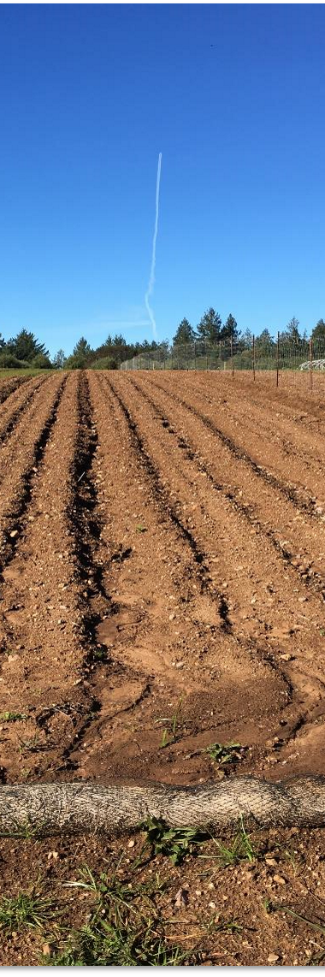
How does tillage impact soil health ?
Compaction
Aggregate stability
Organic matter
Soil organism habitat
Notes:
Ask the group – “How does tillage impact soil health?” and take a handful of responses from participants.
Tillage as a soil disturbance can greatly impact and drive all four of the NRCS soil health resource concerns (listed here). ***Depending on the audience, it may not be necessary to go into much further detail on how tillage affects these resource concerns (as described below).
Tillage can drive compaction by degrading soil structure and reducing pore space. Repeated tillage can also result in compaction layers below the tillage layer.
Tillage degrades aggregate stability by physically disrupting the soil structure. It causes reductions in soil organic matter through disrupting soil structure and aggregates, and by exposing soil organic matter to decomposition by microbes, degradation by sunlight, and oxidation from being exposed to the soil surface.
Tillage degrades soil organism habitat through all of the mechanisms mentioned for the other resource concerns, as well as by reducing residue and cover on the soil surface.
Photo: Josh Beniston, USDA NRCS. Soil health degradation on an organic vegetable farm where a heavy rain fell on soil that had recently undergone intensive tillage.

Slide 4
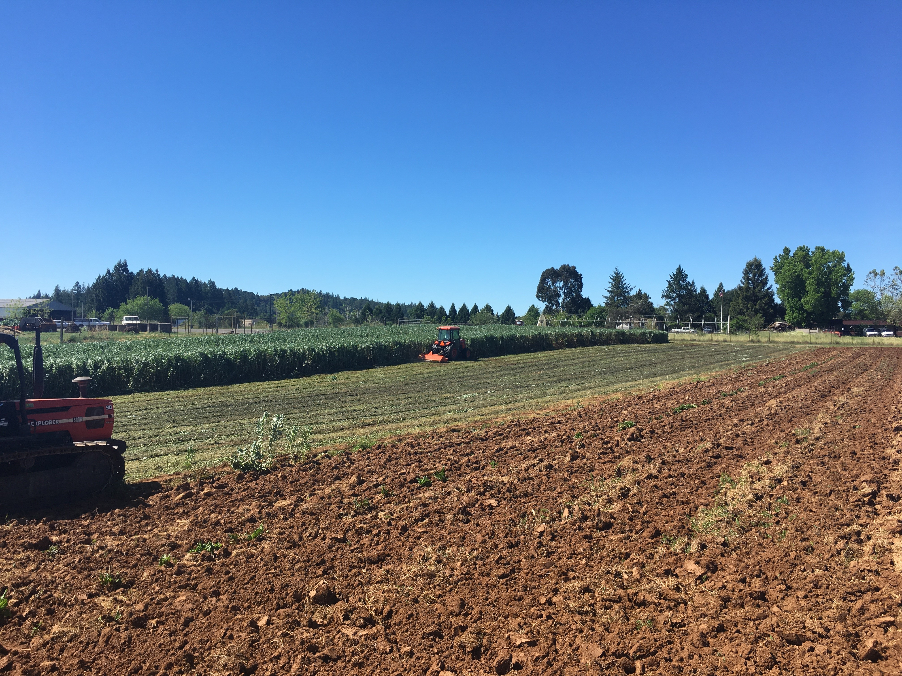
Why do producers use tillage on small farms?
Preparing planting areas
Managing weeds
Incorporating amendments and cover crops.
Notes:
Start with the question to the group – “Why do producers use tillage on small farms?” Take several answers from participants. Acknowledge that there are many reasons why producers utilize tillage and that those activities are likely key to the success of their operations.
Tillage may be particularly common on small-farms as many of those producers align their management with organic methods, regardless of whether they have USDA organic certification. Tillage is used regularly in organic farming to achieve tasks that may be done with synthetic inputs on conventional farms, such as weed management.
Site preparation is often major use of tillage. Size of seed is major determinant of how intense the tillage needs to be.
Adaptive management could be tool for assisting producers in reducing tillage.
Explore non mechanical weeding methods
Photo: Josh Beniston, USDA NRCS. Tillage with a disk harrow was done to incorporate cover crop residues and prepare planting areas on an organic vegetable farm.

Slide 5
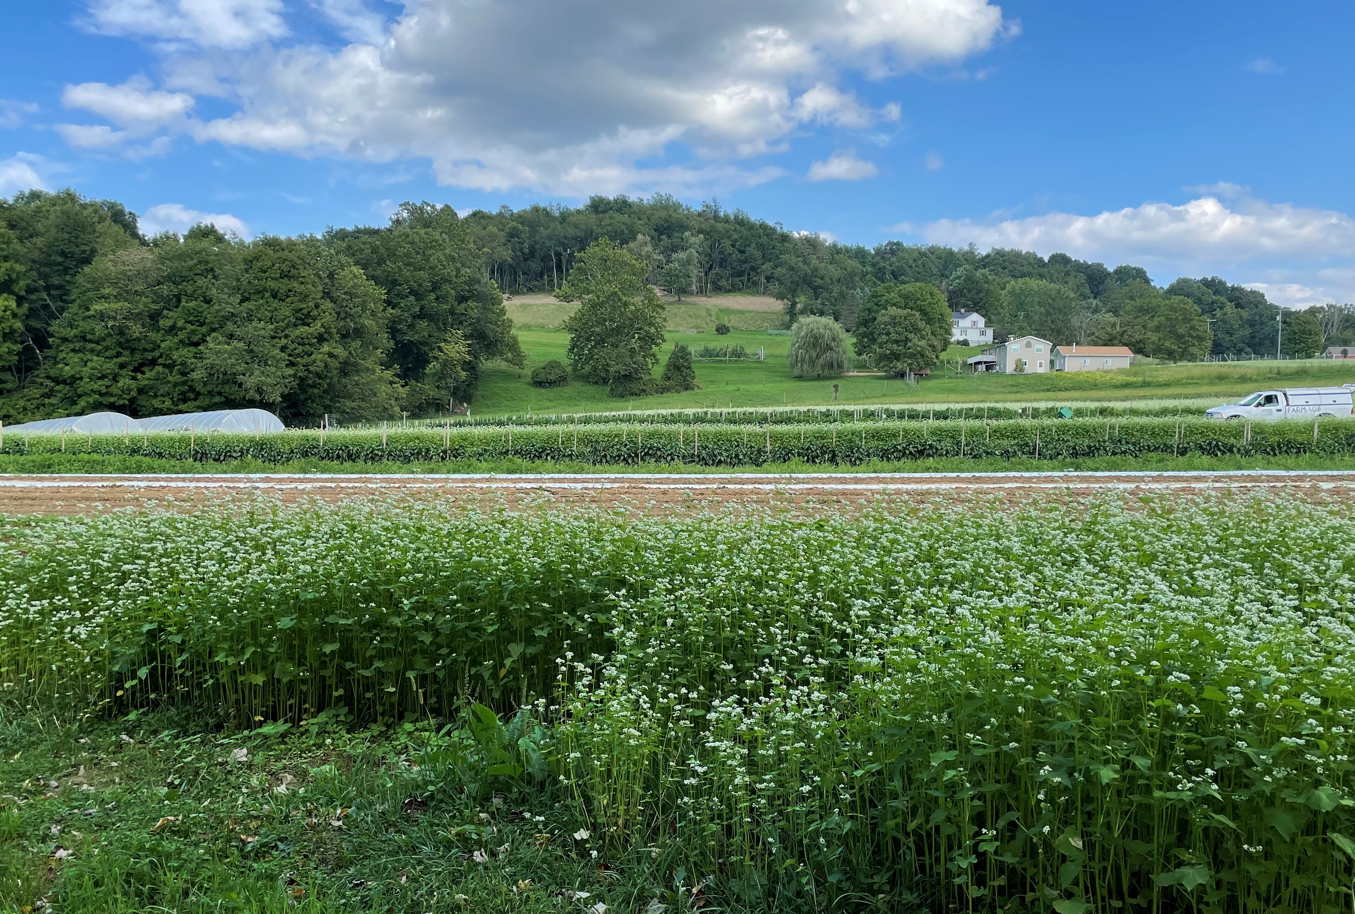
Perspectives on Tillage
Is tillage an “all or nothing”/”black and white” situation?
Is it possible to improve soil health while still utilizing tillage?
Notes:
Ask the group to discuss these two questions. You can ask both questions at once. Take a handful of responses from participants.
There are a couple of key takeaways. (1) Tillage is not an all or nothing situation. On many farms, it is possible to reduce or minimize the disturbance from tillage without eliminating it completely. This is important because for some producers, ie. Organic vegetables, the prospect of eliminating all tillage may not be practical and may require big changes to the way that they farm. In those cases it is best to look for ways to minimize disturbance from tillage, or even optimize it, to reduce soil health impacts but keep the producer in a system that works for their farm.
(2) It is very possible to improve soil health while still utilizing tillage. The Organic Farming Research Foundation (OFRF) has compiled data from a number of studies that demonstrates that soil organic matter can increase on organic farms that are using tillage. Key to that equation is that farms generally must increase their carbon-based amendments to offset the impacts of tillage. Farms increasing organic matter while using tillage are generally utilizing both compost application and cover cropping in their management systems.
This photo was taken at a small-scale organic vegetable farm in West Virginia. NRCS visited the farm as part of a soil health training. We were very impressed with the improvements to soil health that the producer despite doing tillage with a roto-tiller to prepare planting areas. The producers used tillage to incorporate both compost and cover crops. He was also adamant that he only did tillage when he felt that the soil moisture was optimal. Our group could see impressive visual improvements in soil health in the fields that had been in production for a longer time when compared with newer fields and “fencerow” soil.
This photo was taken in August, and the edge of a field planted to a buckwheat cover crop is in the foreground of the picture.
Organic farms with SHMS have demonstrated ability to increase SOM with tillage in systems.
Photo: Josh Beniston, USDA NRCS.

Slide 6
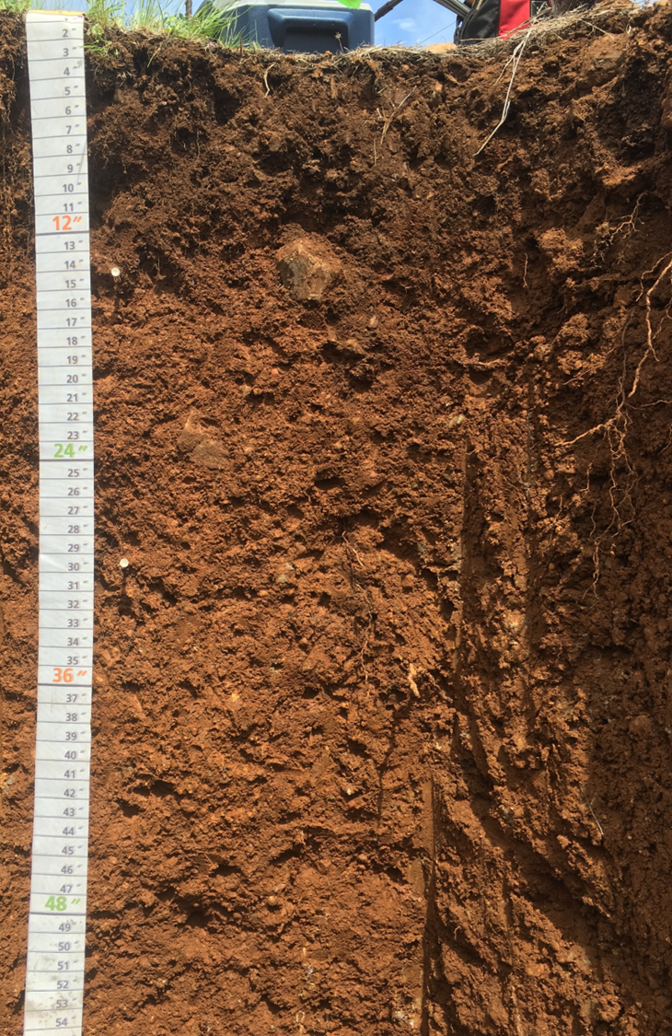
Ways to Think about
Reducing Tillage Impacts
Frequency (or Duration)
Depth
Intensity
Notes:
On the topic of tillage is not an “all or nothing situation” and that we can do things to reduce soil disturbance while still using some tillage – ask the group, what are some different ways of reducing the impacts of tillage? How can we help producers to think about this topic?
Three aspects of tillage that we can explore for ways to reduce the overall impact on soil health are the following: (there may be others also…)
Frequency of tillage – this is how many times do we use tillage operations during a given year or cropping cycle. Are there passes or operations that we can eliminate without harming our management goals?
This is often a good place to start with producers on reducing tillage.
Sometimes the term duration is used in a way that is similar to frequency. Duration also often means, how many years has the current tillage system been in place? In some cropping systems, such as orchards or vineyards, it may be possible to move from management that does tillage every year to one that uses tillage in alternating years.
2. Depth of tillage – the impacts of tillage on soil health tend to be more severe with deeper tillage operations. Some management goals of tillage, such as managing weeds or providing a clean soil surface, can be achieved with very shallow tillage that is essentially only disturbing the top inch or two of soil. Depth of tillage can often be reduced while still achieving management goals. Sometimes this involves using a different piece of equipment.
3. Intensity of tillage – Tools and implements that do more intensive tillage do more to disrupt the soil structure and lead to more significant impacts on soil health. Rototillers are considered particularly intense implements and are common on small farms. So, the goal here is to identify tools and implements that may be used to achieve the management goal, while doing a less intense form of tillage. Many producers focused on reducing tillage impacts have changed the tools that they use to prepare planting areas to less intense implements.
Photo: Josh Beniston, USDA NRCS. Healthy soil profile at a California vineyard.

Slide 7
No Till in Small-scale Agriculture
What are the ways that you have observed small-scale and urban clients reducing or eliminating tillage from their operations?
Notes:
Continuing the discussion – ask the group this question – What are the ways that they have observed small-scale clients reducing or eliminating tillage from their operations? This could be different tools or methods. This could be making big changes in the way that they manage their farms or gardens. What are they observing people doing to reduce the impacts of tillage on soil health?

Slide 8
No Till in Small-scale Agriculture
Permanent Beds
Tools
  Tractor/Walk-behind Implements
  Hand scale tools
Mulching
Notes:
Reducing tillage on small-scale farms has been a very active space of experimentation and discussion in recent years. Producers have pioneered a number of innovations in using tools and in the way that they design their cropping systems and farms to minimize tillage.
We can break these methods into a few different headings. The first heading is permanent bed systems. Next are systems that reduce tillage by utilizing specific tools. Lastly, for this module we will also look at soil management systems that use mulching techniques as a means to reduce or eliminate tillage.
These methods can be used together.

Slide 9
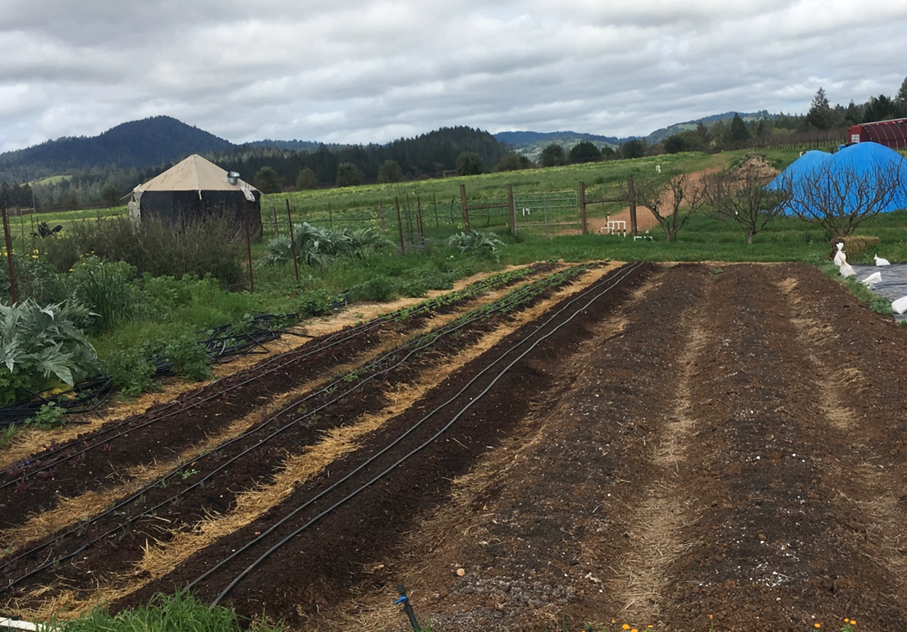
Permanent Beds
Growing areas are divided into growing areas (beds) and pathways.
Compaction is limited to pathways
Management and amendments are focused on beds.
Notes:
Permanent bed systems are set up soil that the growing areas of a field or garden are maintained and managed as growing space, while the pathways are kept as permanent footpaths. This type of field or garden is laid out very precisely during the initial site prep, or transition to permanent beds, and is then maintained in this fashion “permanently” or for several growing seasons. This concept is similar to the concept of the NRCS “Controlled Traffic Farming” conservation practice, but the systems described here are generally managed with hand tools or walk behind tractors. The width of growing beds in a permanent system is often determined by the size and type of tools used to manage the site.
Keeping the beds permanent limits compaction and also minimizes disturbance because the beds do not need to be constructed each year or growing season.
All bullet points on this slide provide key information about the system.
ICPS 812 will allow for raised beds without frame. “Unframed”
Photo: Josh Beniston, USDA NRCS. A small-scale vegetable garden with permanent growing beds and foot pathways.

Slide 10
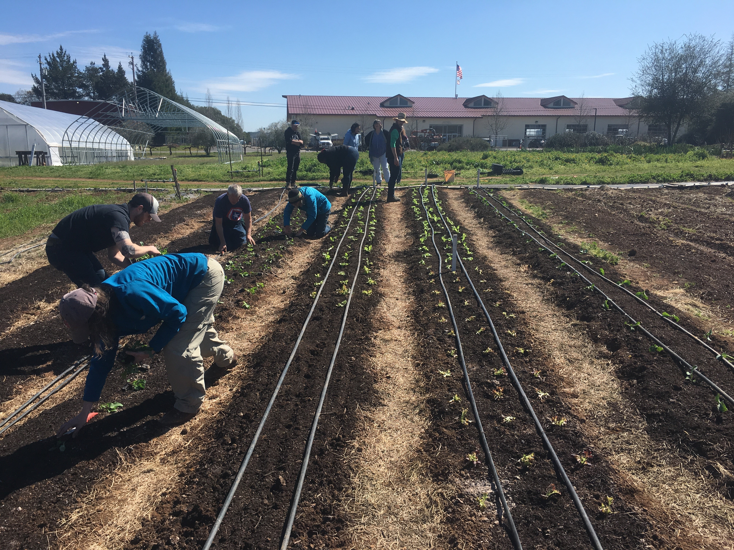
Permanent Beds
Notes:
Students in a sustainable agriculture education program transplanting vegetable seedlings and laying out drip irrigation. They are restricting their movement and traffic to the footpaths. The growing beds at this site are 30 inches wide, with 18 inch footpaths. Most people can easily reach across a 30 in bed.
Photo: Josh Beniston, USDA NRCS.

Slide 11
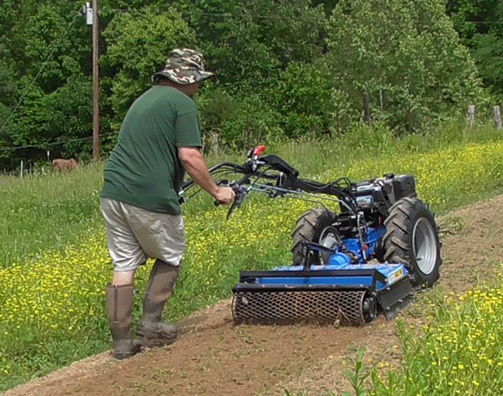
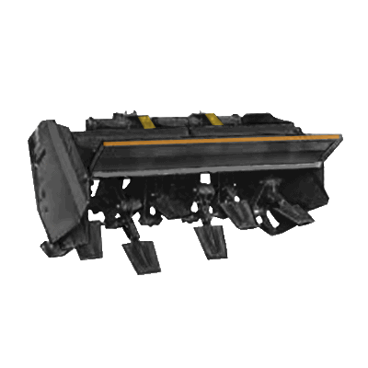
Tools - Implements
Power Harrow
Spader
Tilther at hand scale
Do not invert soil layers.
Very shallow tillage is possible
Notes:
Many implements can be used to complete tillage operations with either a less intensive tillage/soil disturbance or by tilling a shallow depth. These implements include a power harrow and a spader.
The power harrow has vertical tines that stir the soil and do not invert layers. It can be set for a very shallow tillage to prepare seed beds, such as in the top photo here. Harrow is adjustable can be used for very shallow tillage or for deeper tillage
A spader, or rotary spader, is an implement that has small “shovels” that are rotated in a reciprocating fashion. These shovels chop at the ground underneath them and can be used for primary tillage or incorporate of residues and amendments, without inverting soil layers, or causing an intense disruption to the soil structure.
A tilther is a small, hand-scale rototiller that is popular among small scale growers. It is used for shallow tillage of soil surface layers, usually to prepare a bed for seeding or transplanting.
***With any type of tillage tool, the amount of soil disturbance that is caused will be dictated by how the tool is used. The tools listed here can be used for minimal soil disturbance, but can also be used to generate significant soil disturbance. Using tools and implements for minimized soil disturbance requires care and skill on the part of the operator.
Top photo: someone operating a power harrow on a BCS walk behind tractor, from https://www.daileysfarmandbcsshop.com/power-harrow.html
Bottom image: Spader implement, from https://wiki.opensourceecology.org/

Slide 12
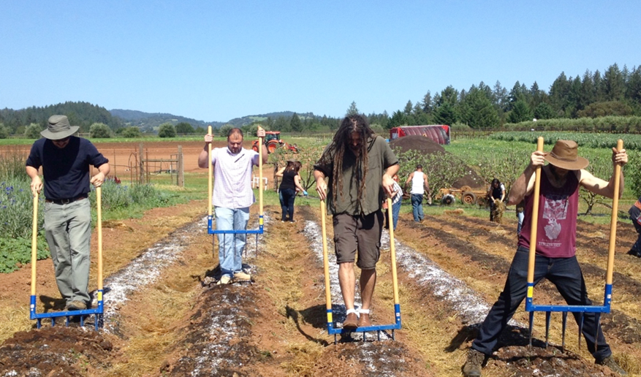
Hand Tools
Broad Forks
Aerate soil.
Incorporate amendments.
Limited disruption of soil structure.
Disturbance is a function of how tool is used.
Notes:
Broad forks are a hand tool that have become very popular in recent years. The bullet points here describe what the tool is used for – aeratind soil, incorporating amendments, and a gentler form of primary tillage. Broadforks cause vertical fracturing in the soil but do not grind up soil structure or invert soil layers. There are several different sizes and styles of broadforks.
Ask participants how many have seen a broadfork used on a small farm? How many participants have tried the tool themselves?
Photo: c/o Santa Rosa Junior College, Sustainable Agriculture Program.

Slide 13
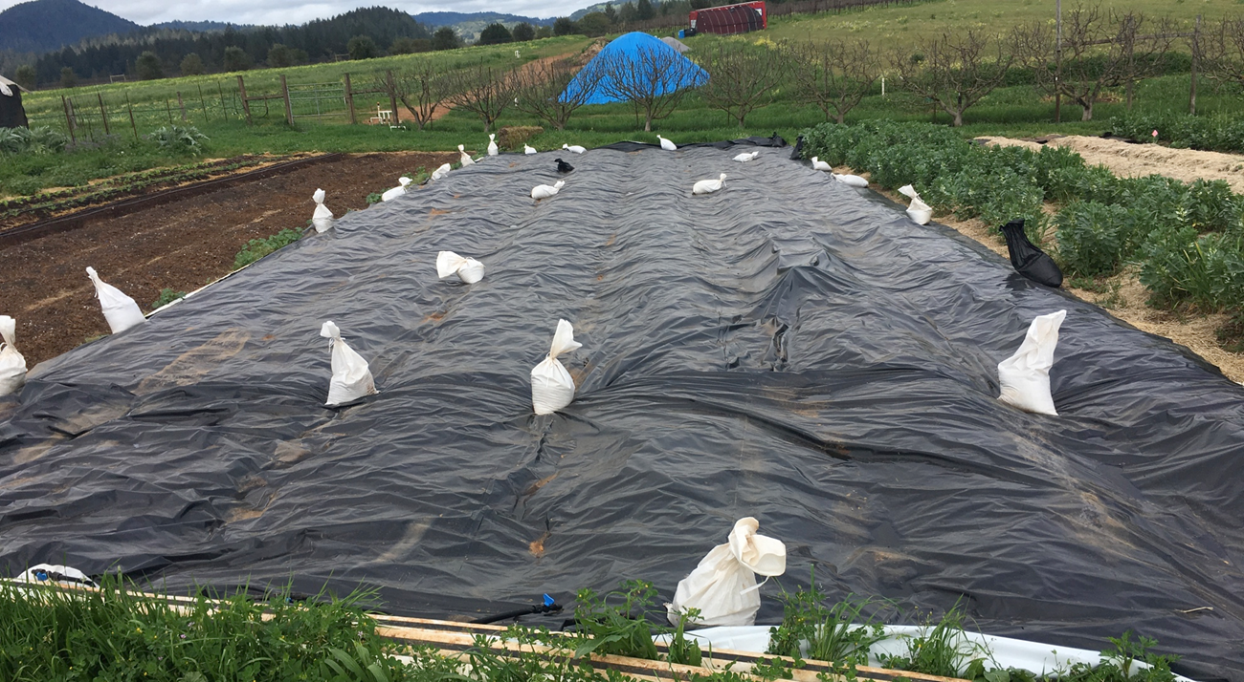
Hand Tools
Tarps
Used to kill weeds or terminate cover crops without tillage.
Cut off plants from sunlight.
Soil organisms consume portions of residue.
Requires approx. one month, depending on conditions
Notes:
The use of tarps for soil management is another practice that has grown in popularity and use in recent years. On many small farms and market gardens, tarps are something of a game changing technique for reducing soil disturbance.
Go through bullet points on the use of tarps.
The amount of time that a tarp must cover the soil to achieve the goal of killing weeds or a mowed cover crop depends in part on the season, weather and soil conditions. Soil is often remarkably “clean” when tarps are removed. Rodents and reptiles both like the conditions under black tarps and this can be one small drawback to the method.
Use of tarps is beneficial to soil health because they cause little to no soil disturbance while supporting goals of weed management and cover cropping.
Silage tarps are the main type of tarp that are used for this purpose. The tarp in the photo is a silage tarp. Other types of tarp materials can also be used for these purposes including black landscape fabric.
Photo: Josh Beniston, USDA NRCS. A silage tarp is covering a block of beds in a garden with permanent beds. In the photo, the tarp is being used to terminate a winter cover crop. The cover crop was mowed with a flail mower and then covered with the tarp for approx. one month. Note the sand bags used to secure the tarp to the ground.

Slide 14
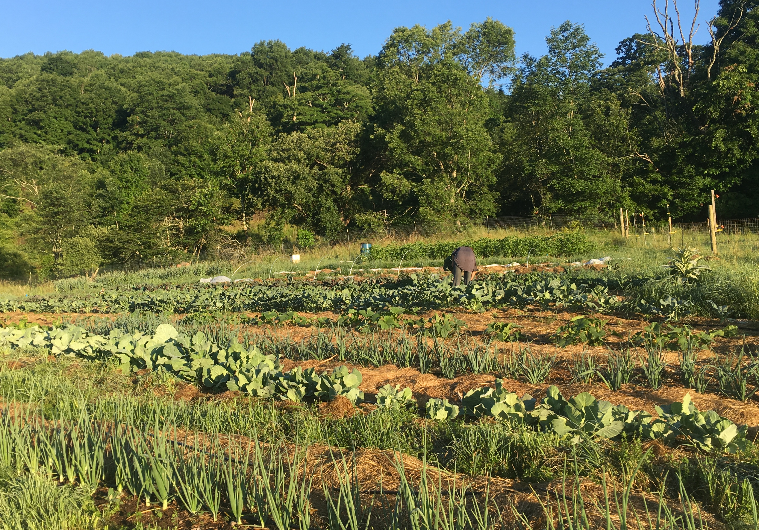
Mulch-based Systems
Range of systems, management and materials vary by context.
Compost mulch production systems.
Deep mulch systems.
Sheet mulch/lasagna garden for new sites.
Notes:
A third broad area of management practices that are used to reduce soil disturbance on small farms are those that we can consider “mulch based systems”. There are many different ways that mulching can be used to reduce tillage on small-scale farms. A few of these methods include:
Compost mulch systems – these systems generally apply a layer of compost to the soil surface as a mulch, at the beginning of the growing season or when transplanting vegetable seedlings. The compost can prevent weeds, adds nutrients and carbon to improve soil health. One caution of compost mulch systems is that soil nutrient levels can go up quickly with regular compost applications.
Deep mulch systems apply several inches of mulch each year to keep the soil covered and eliminate the need for weeding. The large inputs of carbon result in improvements to soil health and function in these systems. The vegetable field in the photo is managed with deep mulching of straw.
Sheet mulching, or lasagna gardening, is a type of deep mulching system that uses layers of mulch material such as wood chips and compost. Sheet mulching typically utilizes a layer of cardboard or newspaper at the soil surface which acts as a weed barrier. Sheet mulching is most often used as low disturbance way fo establish new garden beds. It is a popular method in urban and backyard gardens.
Photo: Elizabeth Marks, USDA NRCS
Could be argued that this is 329 Residue Management
Good question – is this residue and tillage management or is it mulching.

Slide 15
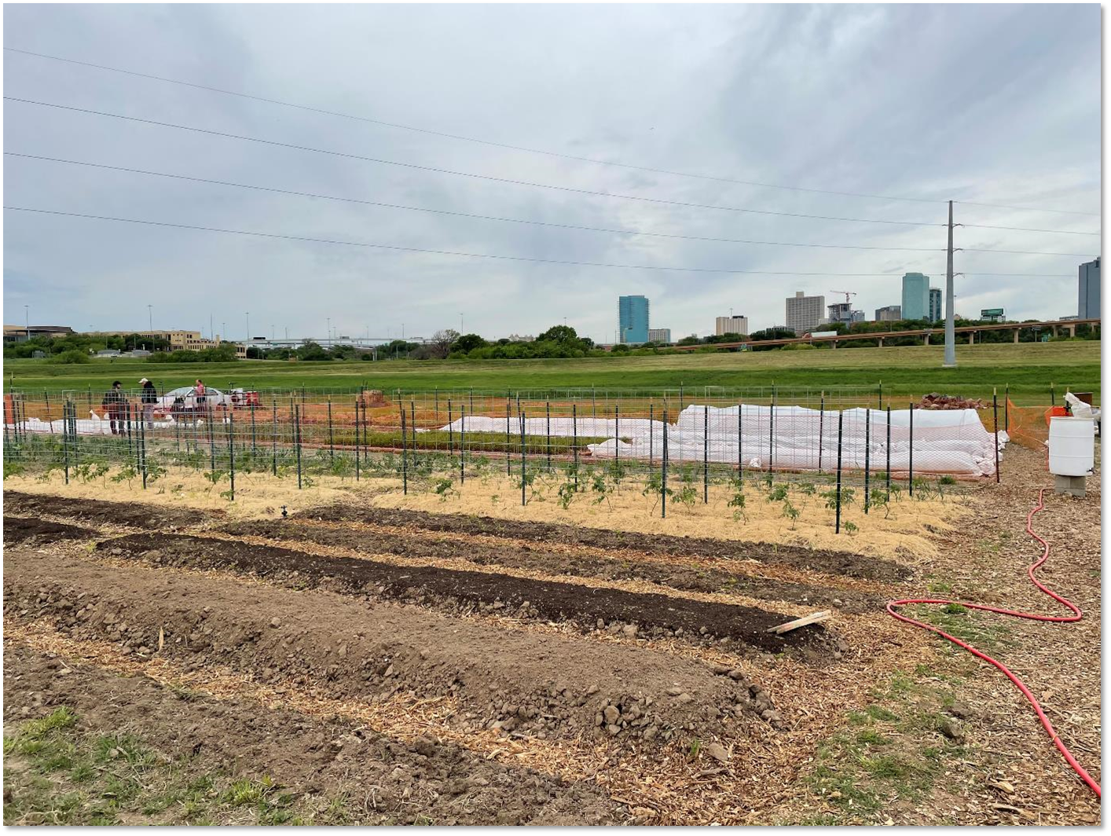
Mulch-based Systems
Notes:
Different mulch materials are used for different soil management purposes on small-scale farms. The market garden in the photo is using at least three distinct mulch strategies to reduce soil disturbance. A transplanted tomato crop has been deep mulched with straw to minimize weeds and improve soil health. A few beds in the photo are being managed with “compost mulch” on their surface. These beds are likely being prepared for transplanting of vegetable crops. All of the pathways in this permanent bed system have been mulched with wood chips to reduce weeds.
Is this a 484 mulch system or 329 residue and tillage management.
Vegetable crops where residue is removed – mulch can be applied as residue management.
484 will have straw “by the bale” scenario
Photo: Josh Beniston, USDA NRCS

Slide 16
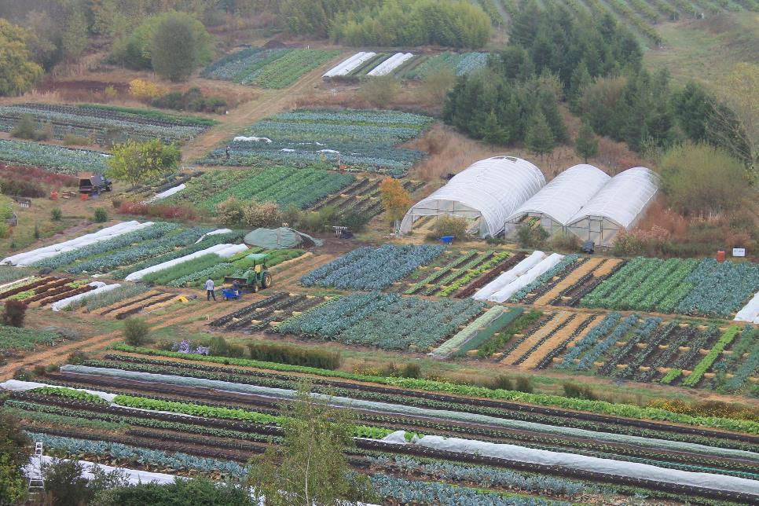
Small-scale No Till Innovators
Image: singingfrogsfarm.com
Image: joegardner.com
Notes:
The increase in interest and adoption of no-till practices by small-scale vegetable growers is a direct result of the work of innovative and pioneering producers who developed no till systems and then worked to promote these systems and educate others. These photos highlight two small-scale, organic no-till innovators:
The photo on the left is Singing Frogs Farm in Sebastopol, CA. The Kaiser family and their crew grow three acres of organic vegetables for sale to local markets. They no longer do any tillage on their farm and are committed to keeping crops and cover crops growing in the soil year round. They work to manage the site according to soil health principles and have greatly increased their soil organic matter and irrigation use efficiency at the site.
The man holding produce in the other photo is Charles Dowding. Charles grows vegetables on less than an acre in England without any tillage. He has a popular youtube channel that describes many of his methods.
Both of these sites could be considered “compost mulch” systems, as surface applied compost before planting/transplanting is a key management practice for both producers.
Photos: Singing Frogs Farm - singingfrogsfarm.com; and Charles Dowding – image from the Joe Gardener show - joegardner.com

Slide 17
No Till in Action – the “Bed Flip”
Singing Frogs Farm, Sebastopol CA
https://www.singingfrogsfarm.com/principles
Notes:
This link shows the far crew at Singing Frogs Farm “flipping a bed”, or transitioning a few garden beds from a crop that is completed to the transplanting of a new crop. Singing Frogs work to transplant new crops into beds where old crops have been removed on the same day, in an effort to maximize the time that living roots are growing in the beds.
A few key things to note in the video. They remove the aboveground biomass but leave root system behind to feed the soil in the majority of their crops. After removing the crop, they apply fertilizers and then mulch the bed with compost. This provides fertility and also acts as a mulch to cover weed seeds.

Slide 18
Small-scale No Till and NRCS
Have you used the Residue and Tillage Management, Reduced Till (CPS 345) or Residue and Tillage Management, No Till (CPS 329) conservation practices in small-scale settings?
Notes:
Ask the participants in the training if they have used either of the NRCS Residue and Tillage Management practices on small farms that are utilizing the techniques described in this module.

Slide 19
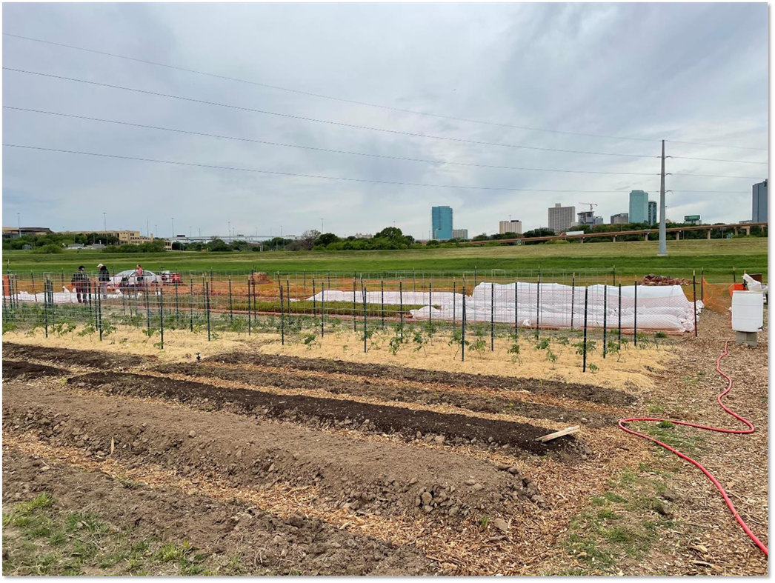
Residue and Tillage Management, Reduced Till (CPS 345)
“Managing residue while limiting soil disturbance”
Includes tillage methods…where the entire soil surface may be disturbed by tillage operations
The STIR value shall include all soil disturbance field operations that are performed during the crop interval (<80)
Notes:
This slide lays out some of the key criteria for thinking about the application of NRCS CPS 345 in these kinds of small scale systems. The first bullet point here is very key – that 345 allows for some soil disturbance.
STIR values are key to the criteria of CPS 345. Currently, this is somewhat limiting in this context because many of the small-scale tools highlighted here are not part of RUSLE 2.
Most of what we saw in the slides falls here. 345 works well in most of these reduced till settings
Key question becomes “are we looking at whole field, or are we looking at bed”
Text in italics are comments from NRCS National Agronomist

Slide 20
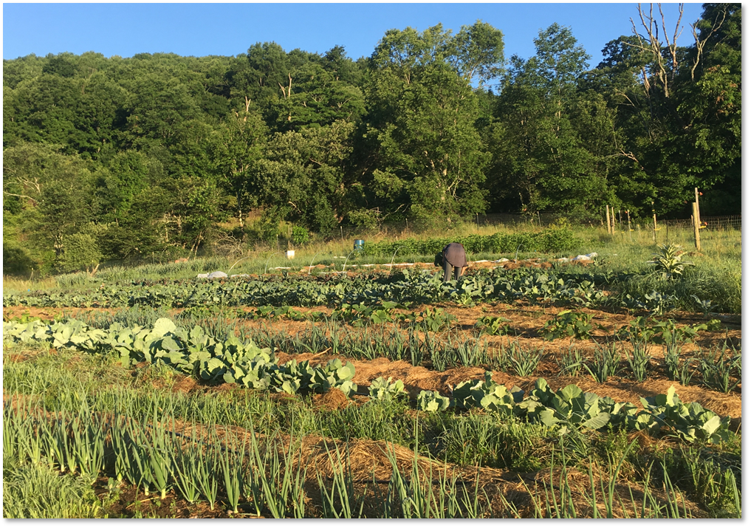
Residue and Tillage Management,
No Till (CPS 329)
There is no full-width soil disturbance performed from the time immediately following harvest or termination of one cash crop through harvest or termination of the next cash crop in the rotation regardless of the depth of the tillage operation.
The crop interval STIR value shall be no greater than 20.
Notes:
CPS 329 – Residue and Tillage Management, No Till, is more restrictive than 345. There is to be no full width soil disturbance for this practice to apply. The management systems described in this module that best fit this definition are the mulch-based systems, such as the deep mulch system in the photo here.
STIR values are also important to the interpretation of this practice standard.
Crimping as management practice should also fit in this practice standard.

Slide 21
Key Points on Residue and Tillage Conservation Practices in Small-scale Operations
Tillage systems based on implements and tools, generally fit better with 345.
Mulch based systems may qualify for 329.
  Potentially using
Maintain residue cover.
If crop residue is removed for vegetable crops, it can be replaced with mulch materials.
Notes:
A few key points on tat provide a summary of the application of the NRCS Residue and Tillage Management conservation practices to small-scale systems.
One point not addressed earlier is that residue cover must be maintained on the soil in these practices. In vegetable systems where crop residues are removed, it becomes important to replace those with mulch materials.
This is a good place for any further discussion or questions relating to these conservation practices and the information presented.

Slide 22
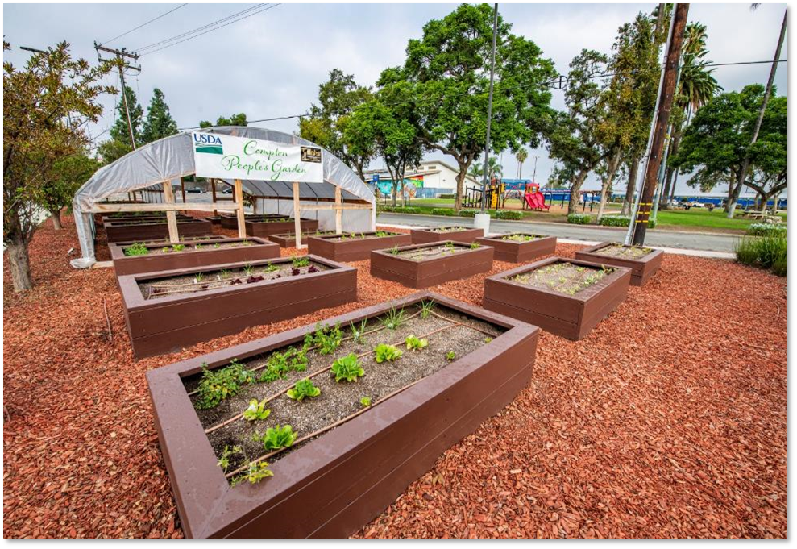
Raised Beds practice (Interim CPS 812)
Notes:
We now transition the presentation to a discussion of the the NRCS Raised Beds practice – Interim CPS 812. This practice has multiple benefits for the client, but a very specific purpose within NRCS.
Photo: USDA flickr – the People’s Garden in Compton, CA. Constructed raised beds are used for all growing and all unused space is covered in thick mulch of wood chips.

Slide 23
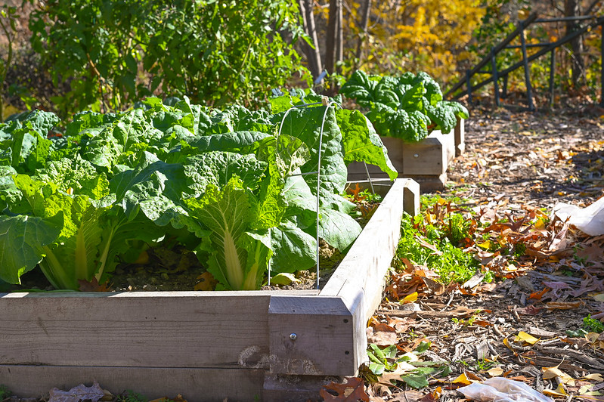
Raised Beds
Are you using the Raised Beds practice in your office or state?
Notes:
Ask Question to group – Are they using this practice in their state? Take a few responses and any discussion.
Photo: Elizabeth Marks, USDA NRCS

Slide 24
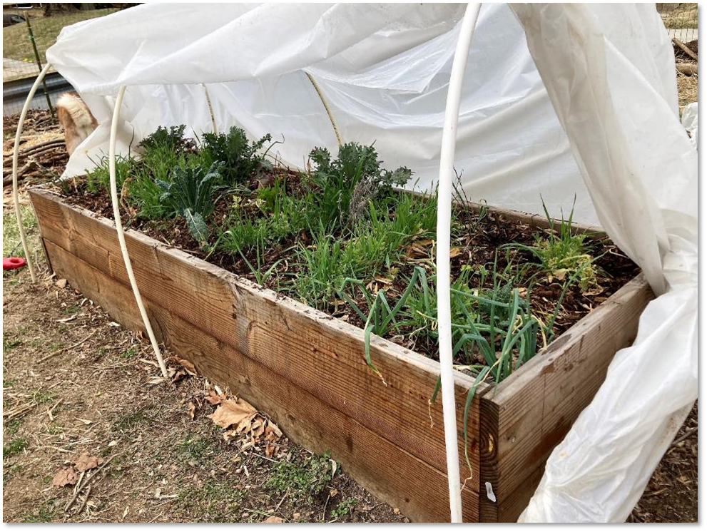
Raised Beds
Definition: Create an above ground growing environment.
Purposes:
  Reduce concentration of salts or other chemicals in the soil that limit the desired use
  Reduce field operation-induced particulate emissions within the raised bed footprint
  Increase plant health and productivity
Original intent to address Farm Bill Soil Remediation
Notes:
This practice is intended to “create an above ground growing environment” on sites where the ground is considered “unsuitable” for growing crops (this distinction is discussed in an upcoming slide).
Something interesting about this interim practices is that it is a direct result of the 2018 Farm Bill. That Farm Bill contained language directing USDA to create practices to support “soil remediation” for urban agriculture. While raised beds do not “remediate” soil, they do allow clients to grow crops with reduced risk on sites where the soil may need remediation for heavy metal contamination. It is a good example of NRCS responding to a mandate from congress.
Photo: Valerie Cohen, USDA NRCS.

Slide 25
Conditions Where the Practice Applies
Existing soil conditions are unsuitable for agricultural production due to contaminants and/or debris.
Other site conditions must be documented showing the soil as unsuitable for production AND no alternative site is available.
Other site conditions:
  Coarse gravel, stone, rock, etc.
  Backyard septic fields
  Shallow depth to bedrock
  Construction compaction
Notes:
These are the conditions where this NRCS practice standard applies. This practice is somewhat restrictive in that it is only to be used when “existing soil conditions are unsuitable for agricultural production.”
Soil contamination, either documented with soil testing or cited as a major concern by client/planner, is a primary trigger for this practice. It can also be used at sites with excessive debris/coarse fragments, or sites matching the descriptions provided in the third bullet point here.
Many potential benefits to client when using this practice.

Slide 26
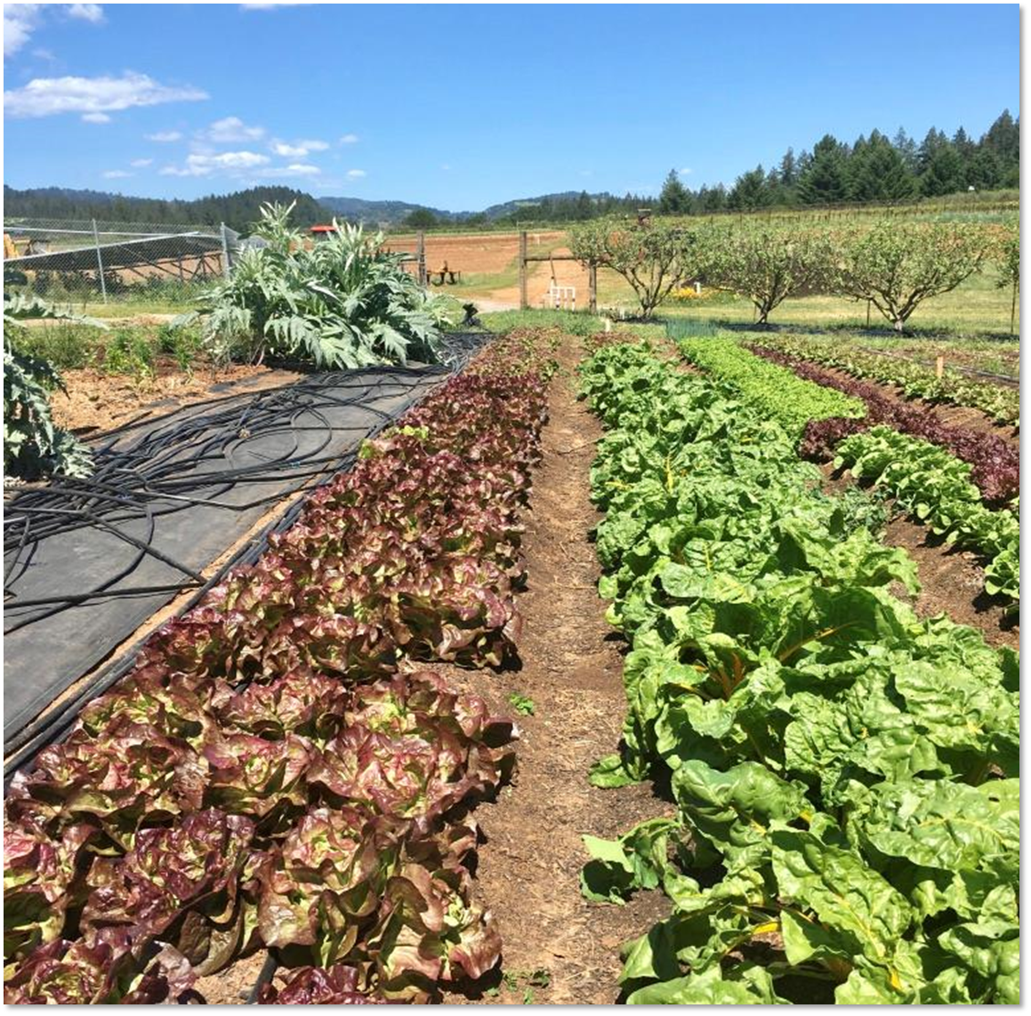
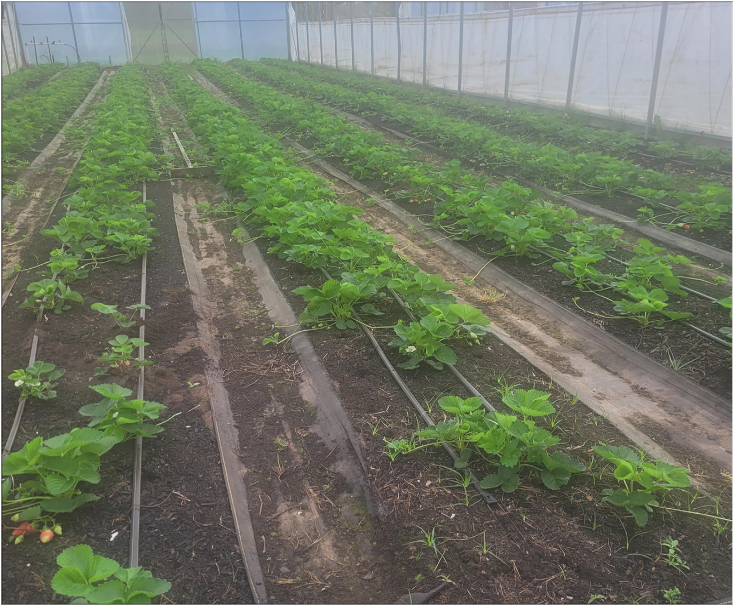
Can raised beds be used in these scenarios ??
No soil limitations observed.
Land is already in crop production.
Notes:
Ask group the question, can this practice be used at sites that look like the sites in the photos?
Answer is no – this practice is not intended for sites that are currently growing crops or sites falling on traditional cropland.
Standard is for sites where soil in current condition is not suitable for crop production

Slide 27
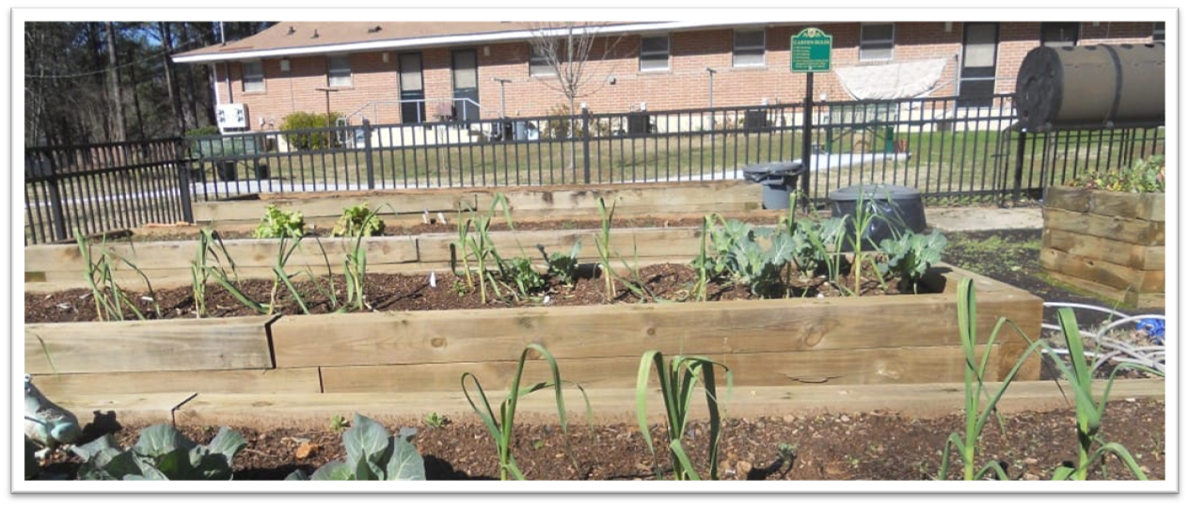
Operation & Maintenance
On sites where heavy metal contamination is known to be present, soil test the growing medium will occur every 3 years according to LGU or other state guidelines. At a minimum test for known contaminants found within the region.
Test soils for Agronomic properties every 3 years according to LGU guidelines.
Replenish or maintain growing medium as needed to maintain adequate soil depth.
Notes:
Bullet points on this slide provide some basic recommendations for management of constructed raised beds.
Nutrient management plan is recommended to guide soil testing and amendments.
General recommendations of adding 3 inches per year
Slide is courtesy of Allen Moody, USDA NRCS.

Slide 28
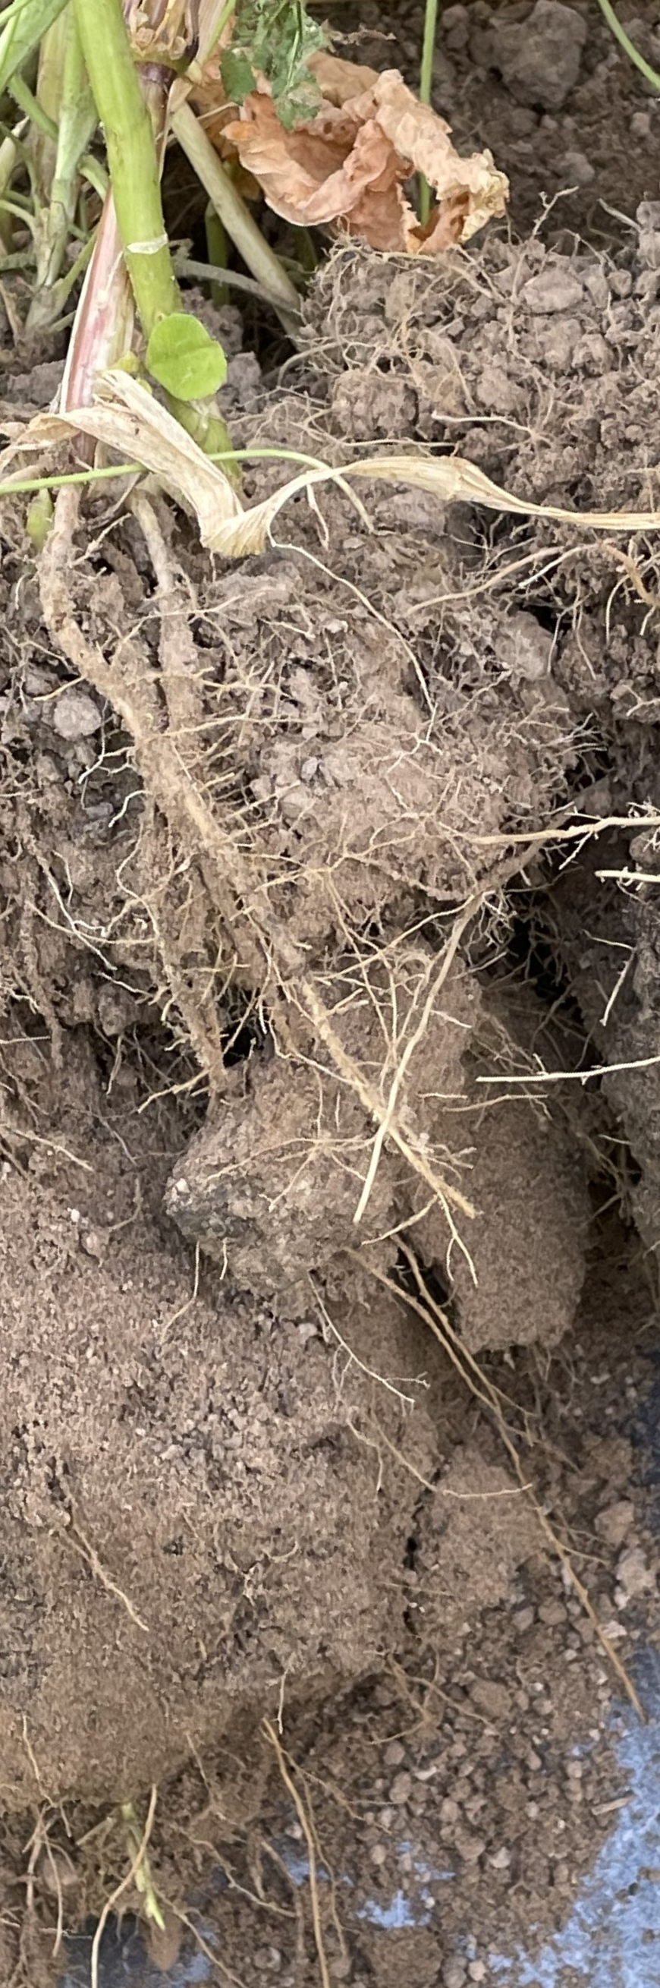
– Physical Effect on SH Resource Concerns
Compaction:
Soil organism habitat:
Aggregate instability:
Organic matter depletion:

Slide 29
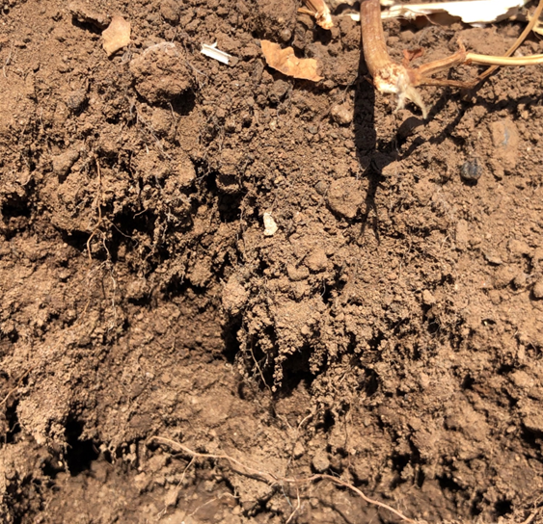
Case study on Soil Health and Tillage in Small-scale Vegetable Production in CA
Photos and Soil Descriptions by Phil Smith, NRCS CA
Notes:
The next several slides will demonstrate differences in soil health between areas of the same farm and soil that are managed with conventional tillage vs an area with highly reduced tillage.

Slide 30
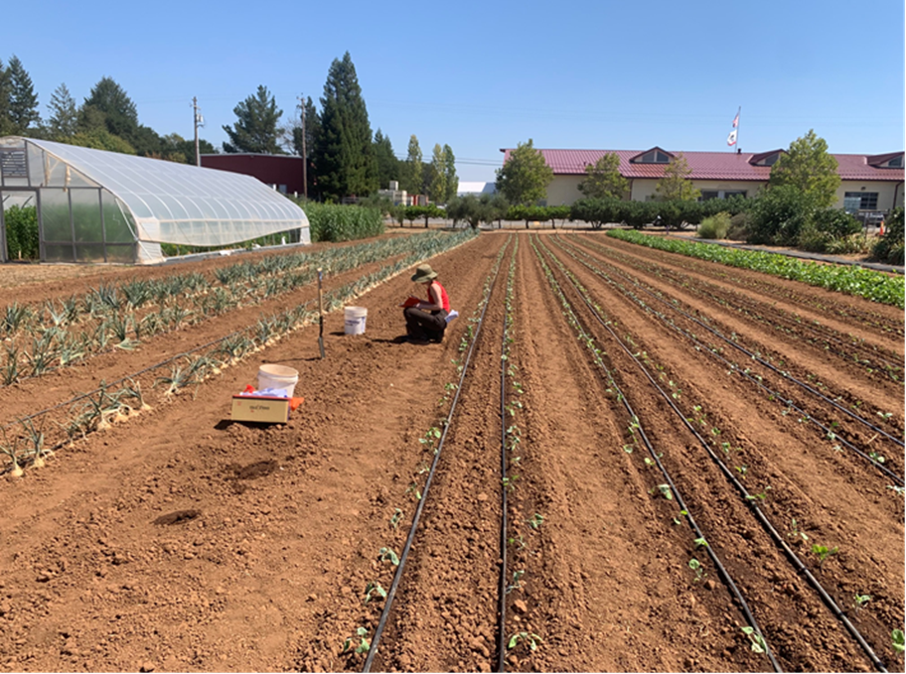
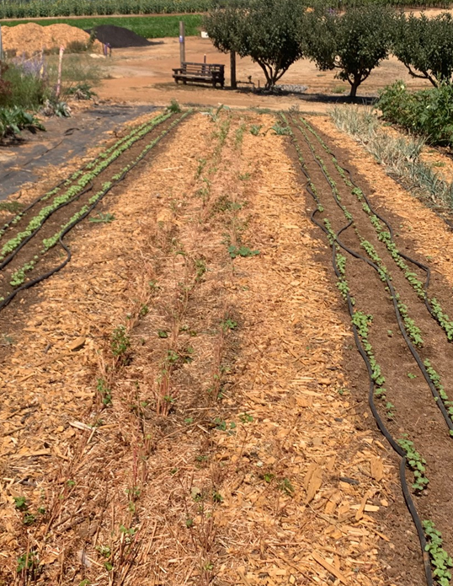
Soil management
Conventional Tillage
No Till
Notes:
All of the photos in this section were taken on the same day. They document different in the same soil type in two adjacent areas on an organic vegetable farm. The conventional tillage is managed with tractor tillage – disking followed by rototilling, before transplanting of vegetables. This area does get a winter cover crop and occasional applications of compost or organic material.
The no-till area is a garden managed with had tools. This area was transitioned to no-till management, which did include annual disturbance with broadforks. The management was focused on compost mulch system, with heavy annual applications of compost prior to planting. This area also has annual winter cover cropping. The no till management had been in place for around 7 years at the time of this study. In the two years leading up to this study there had been some tillage with a power implement tool.
These soils are the same soil type, Pleasanton clay loam.
Photos: Phil Smith, USDA NRCS

Slide 31
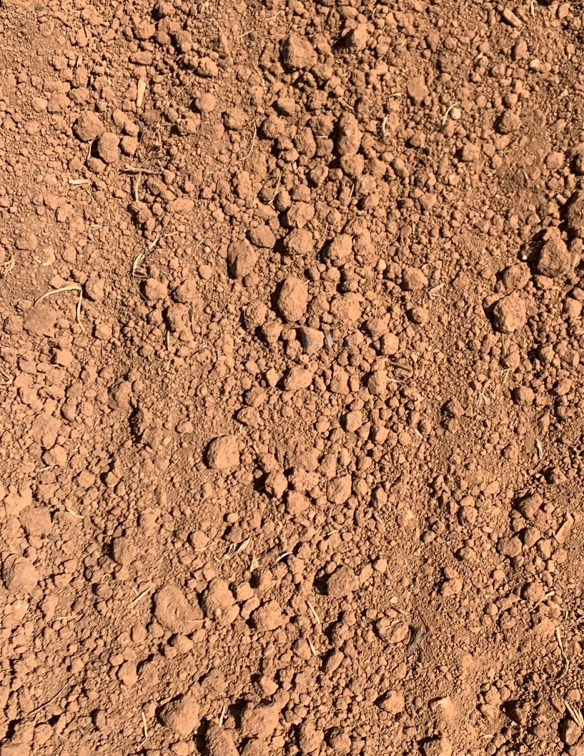
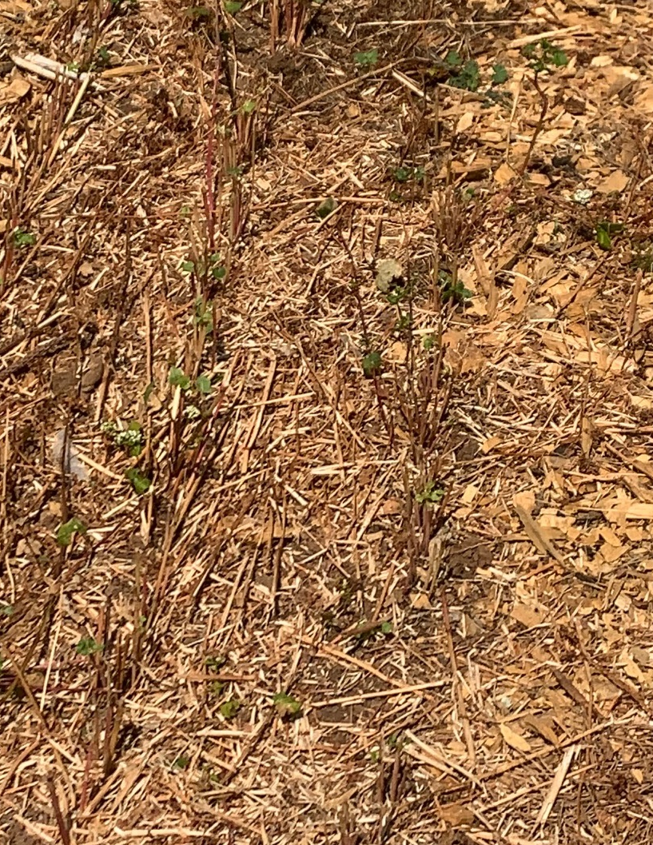
Soil cover
Conventional Tillage
No Till
Notes:
The soil surface in the two systems – bare soil and disturbed structure in the conventional tillage and full cover by residue and mulch in the no till system.
Photos: Phil Smith, USDA NRCS

Slide 32
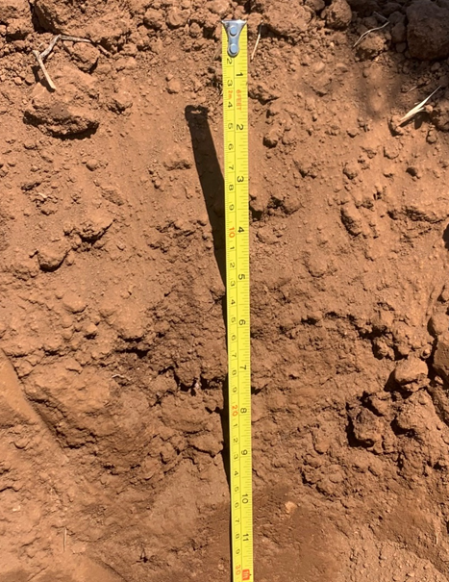
Conventional Tillage
Soil Profile
Ap: (upper part dry, lower moist)
7.5 YR 3/2 clay loam, loose clods and single grain, dry; no living or dead roots observed
Bt: (moist throughout)
7.5 YR 3/3 clay loam, firm; no roots observed, no pores observed, wire flag cannot penetrate; pH 7.9
Compared to no-till, Bt is more difficult to pluck with soil knife; wire flag stopped 3 out of 4 times at top of horizon (10 inches)
Notes:
Description of a partial soil profile in the conventional tillage.
Loose clods and single grain structure in A horizon. Wire flag could not penetrate B horizon. This observed compaction may be result of a tillage induced hard pan at 10 in depth.
Profile descriptions and photos: Phil Smith, USDA NRCS

Slide 33
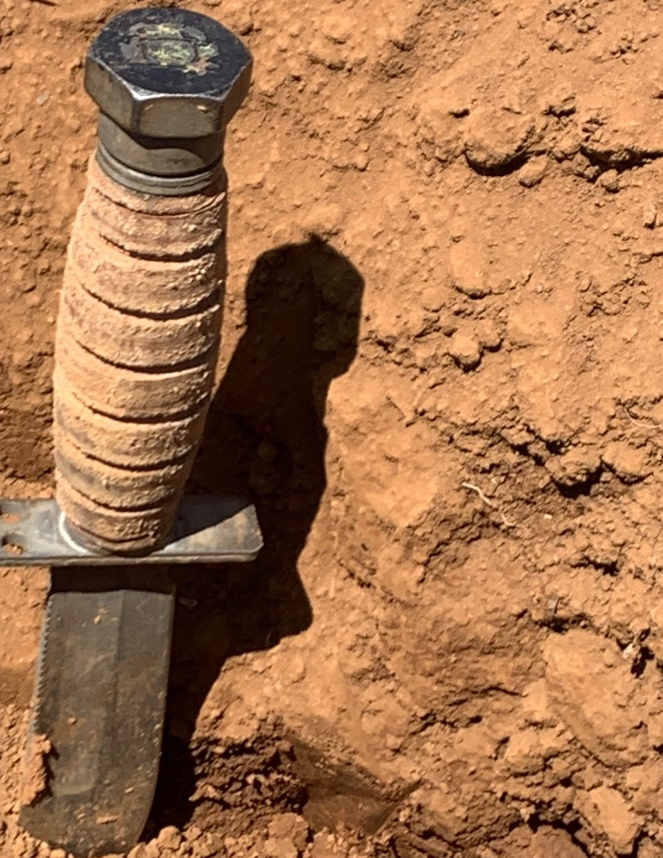
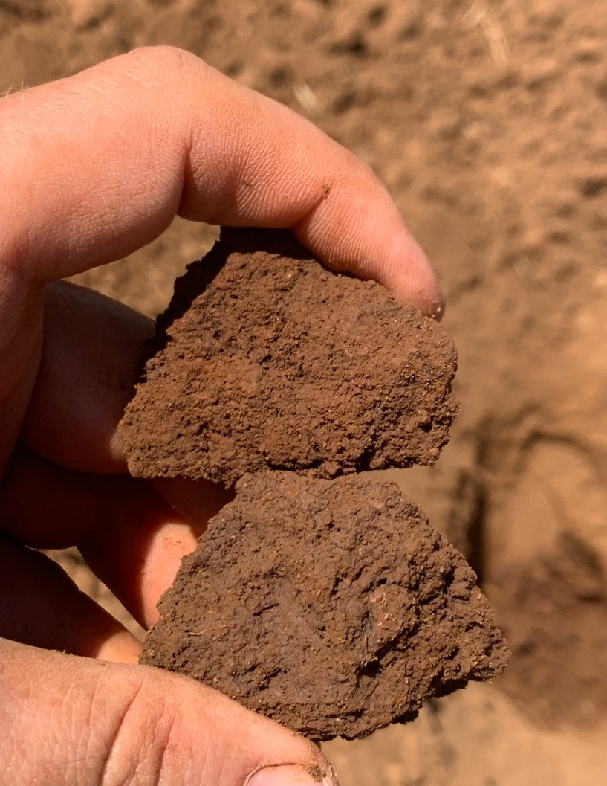
Conventional Tillage Soil Profile - Peds
Notes:
Photos: Phil Smith, USDA NRCS.

Slide 34
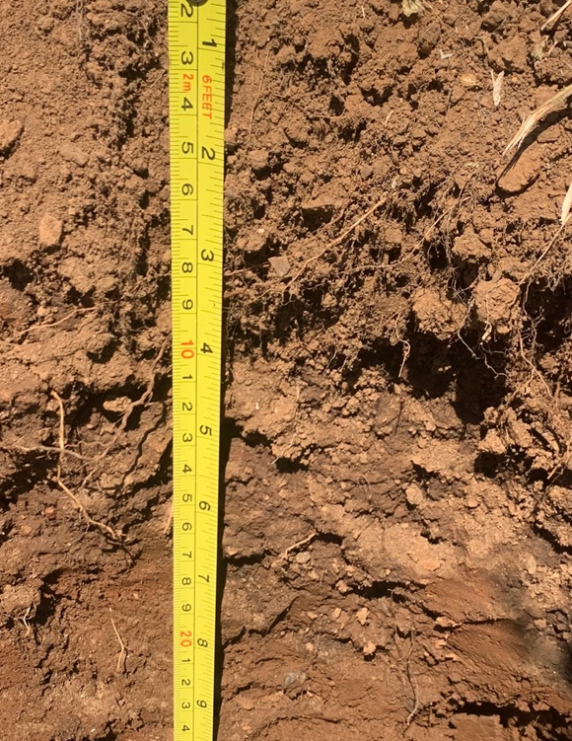
No Till Soil Profile
Ap: (upper dry, lower moist)
7.5 YR 3/2 clay loam, friable, strong medium granular structure, common very fine, fine roots: pH: 7.1
Bt: (moist throughout)
7.5 YR 3/3 clay loam, friable, moderate fine and medium SBK moderate medium SBK; few fine and very fine roots; common very fine, fine tubular and dentric tubular pores; pH 7.9
Both horizons easily plucked with knife, wire flag penetrate >20 inches
Notes:
Description of partial soil profile. Strong granular structure and common fine roots in surface layer. Moisture and roots throughout profile. Wire flag penetrates more than 20 inches into this soil.
Huge difference in soil structure compared with conventional tillage area.
Photos: Phil Smith, USDA NRCS

Slide 35

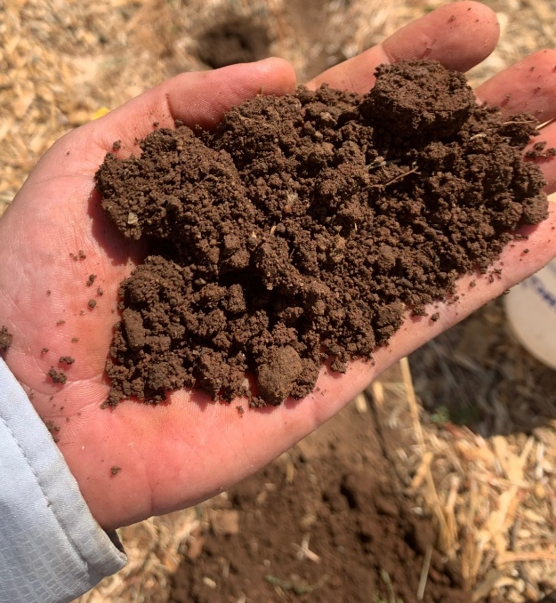
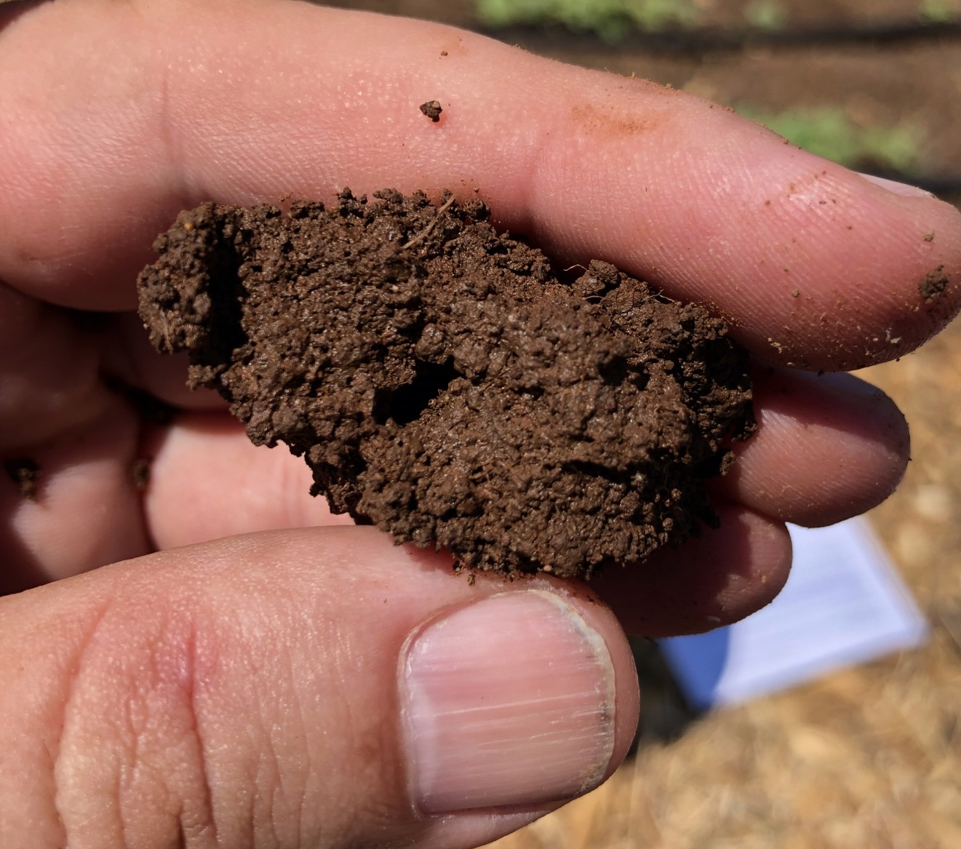
No Till Soil Profile - Peds
Notes:
Soil structure in No Till soil
Photos: Phil Smith, USDA NRCS

Slide 36
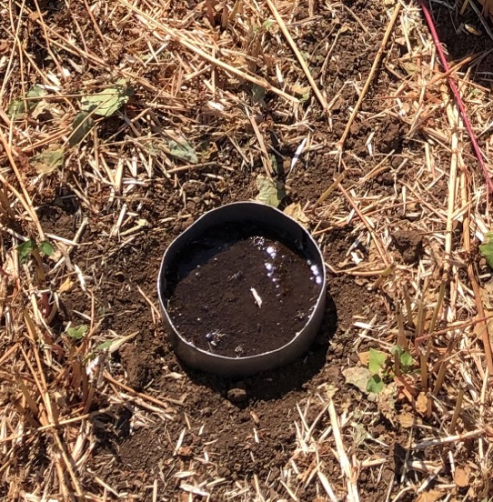
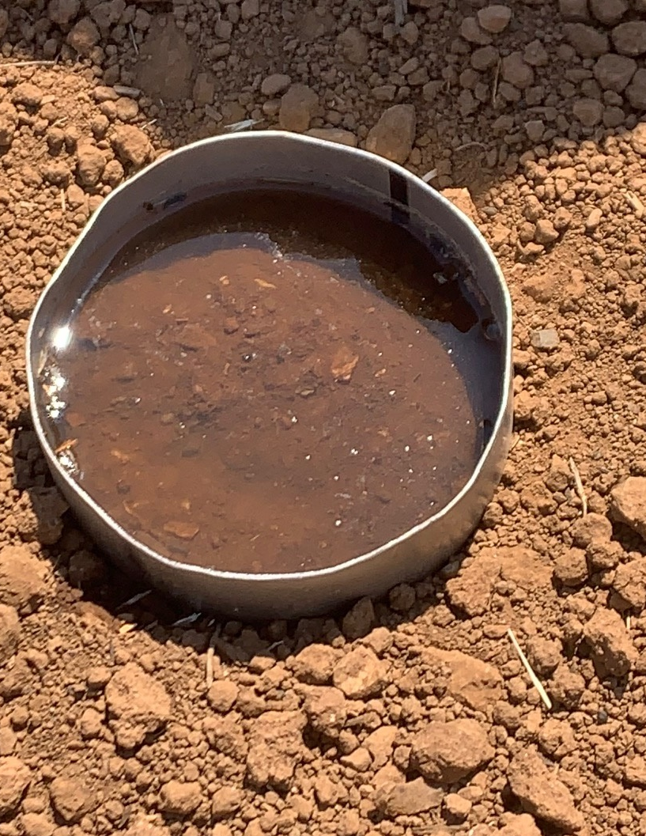
Water Infiltration
No – till
1st inch applied: 0:35
2nd inch applied: 1:24
Conventional Tillage
1st inch applied: 1:31
2nd inch applied: 5:40
Notes:
Water infiltration in two soils. Much faster water infiltration in no till soil.
Photos: Phil Smith, USDA NRCS

Slide 37
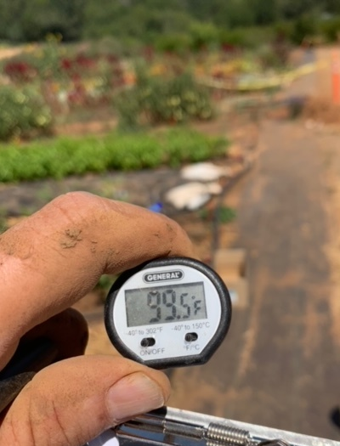
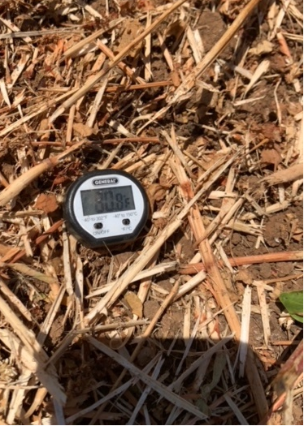
Soil Temperature
Air Temperature: 99.5 deg F
Soil Temps:
No Till:
1 inch - 100 deg F
4.5 inch – 79.5 deg F
Conventional:
1 inch – 115.5 deg F
4.5 inch – 86.5 deg F
Notes:
Soil temperature in two soils. Key to note that this study was done during the summer and the air temperature was 99.5 F.
Photos: Phil Smith, USDA NRCS

Slide 38
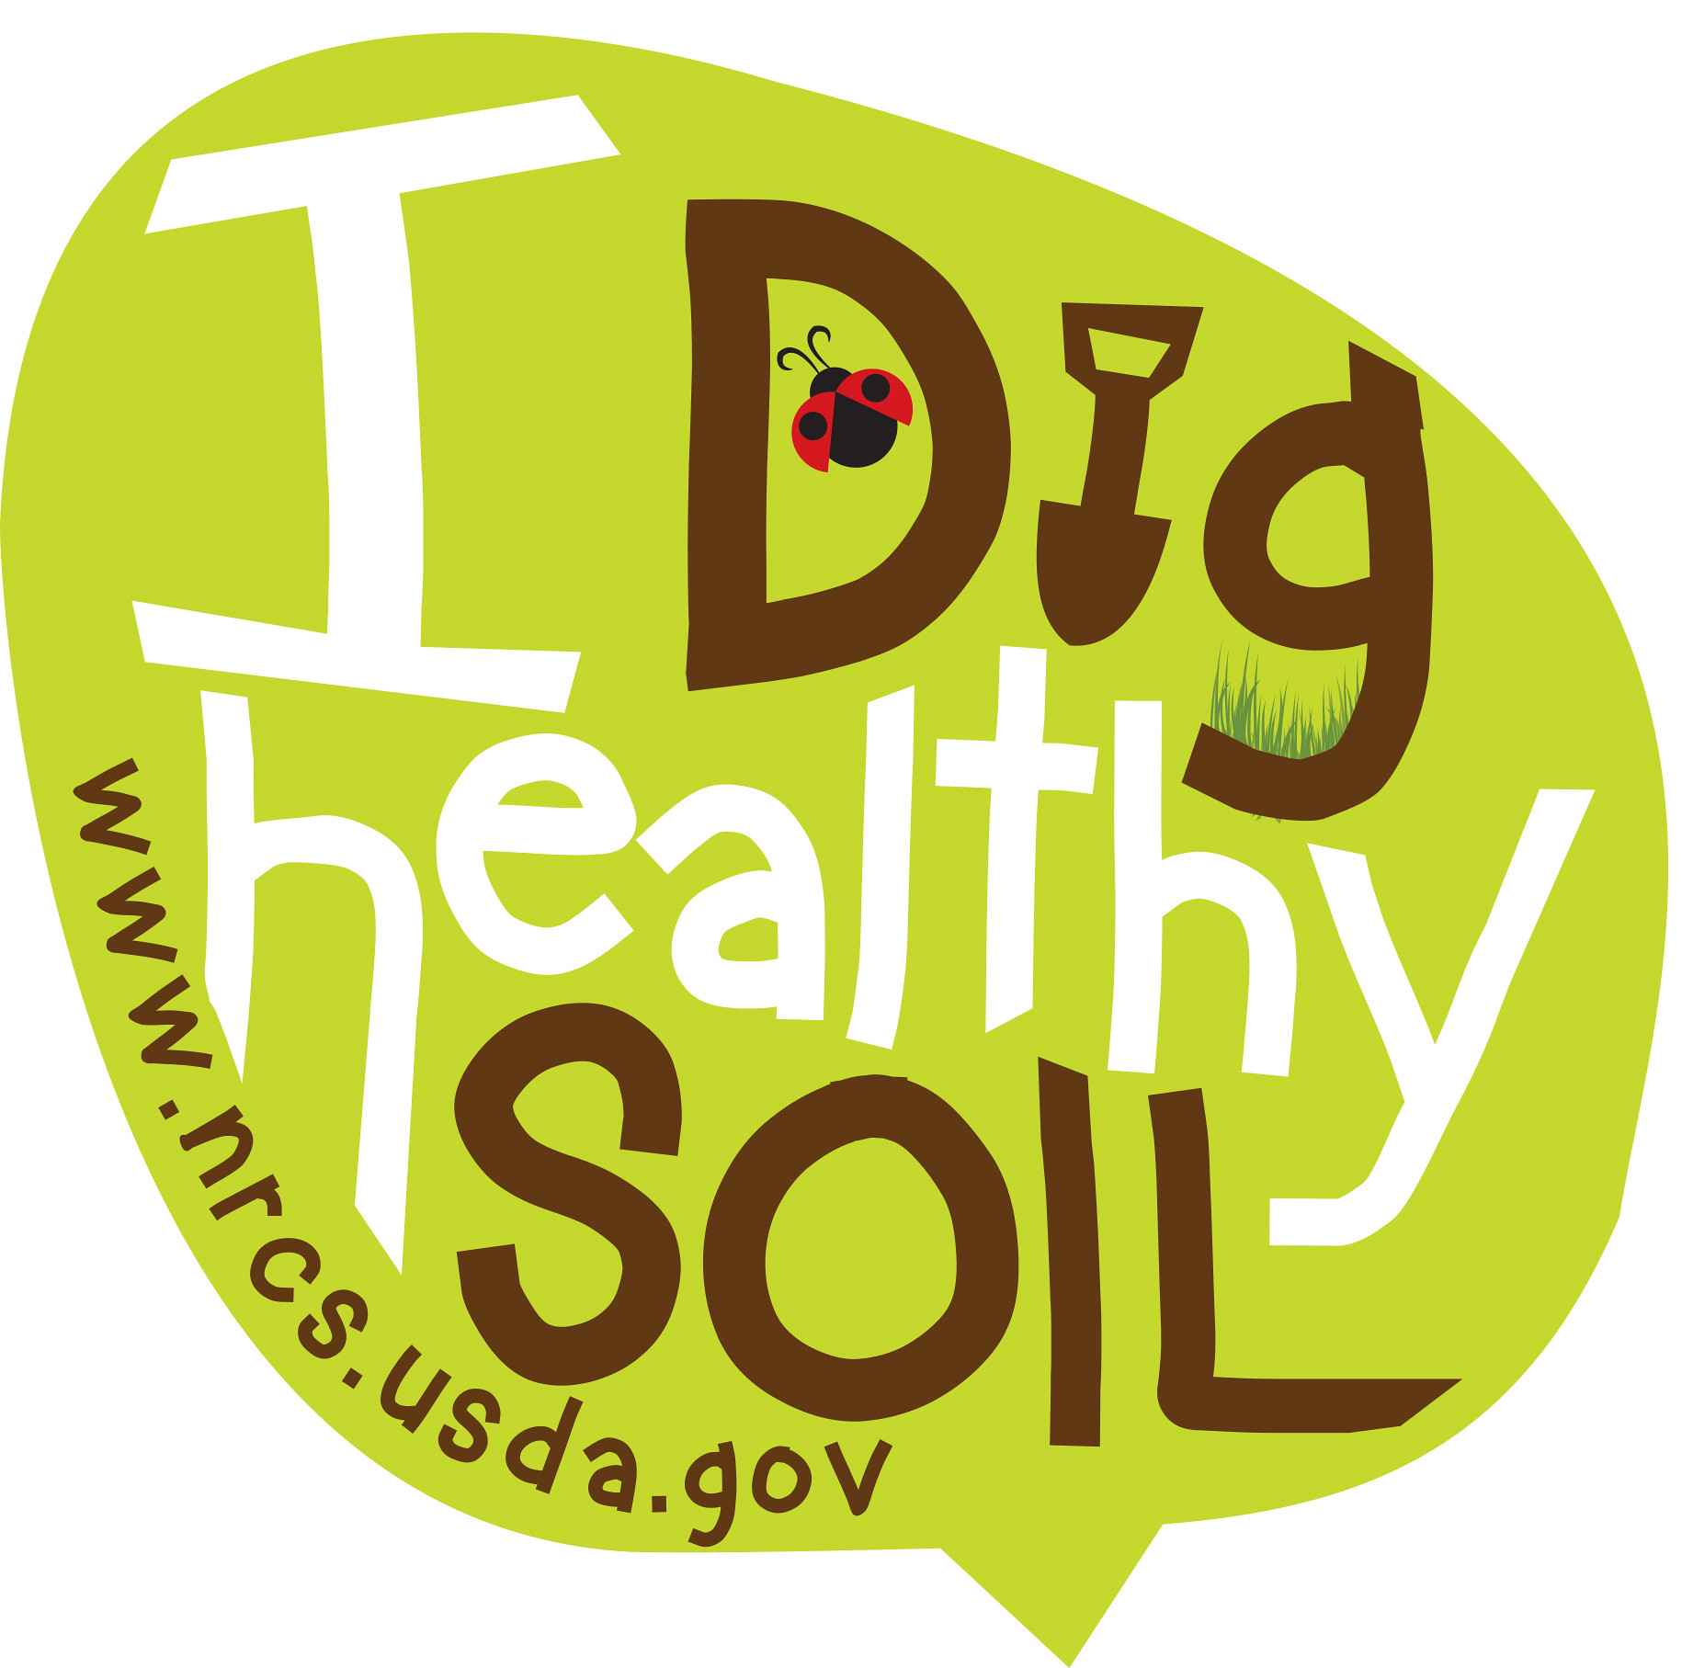
Questions and Review

Slide 39

This information is provided as a public service and constitutes no endorsement by the United States Department of Agriculture or the Natural Resources Conservation Service of any service, supply, or equipment listed.
While an effort has been made to provide a complete and accurate listing of services, supplies, and equipment, omissions or other errors may occur and, therefore, other available sources of information should be consulted
The USDA is an equal opportunity provider and employer.
Meeh, NRCS

